Slide 1
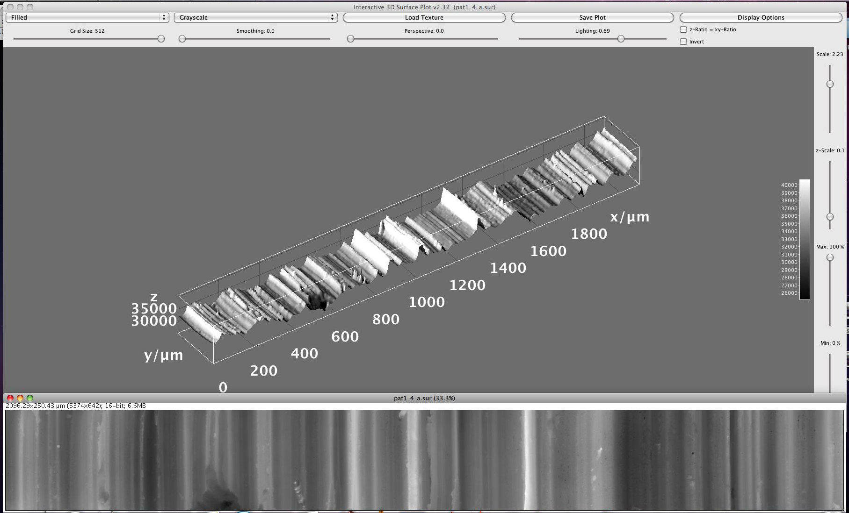


Hands-on Introduction to Mathematica

Slide 2
What is Mathematica?
Primarily a computer program to do symbolic algebra and calculus
Does Plotting, Numerical and Web stuff too.
Very similar to Maple (beloved by Dr. Shenkin)
Mathematica (or Maple) will help you do parts of homework problems and exam questions
I’ll tutor Mathematica, but you may use Maple if you feel more comfortable with it.

Slide 3
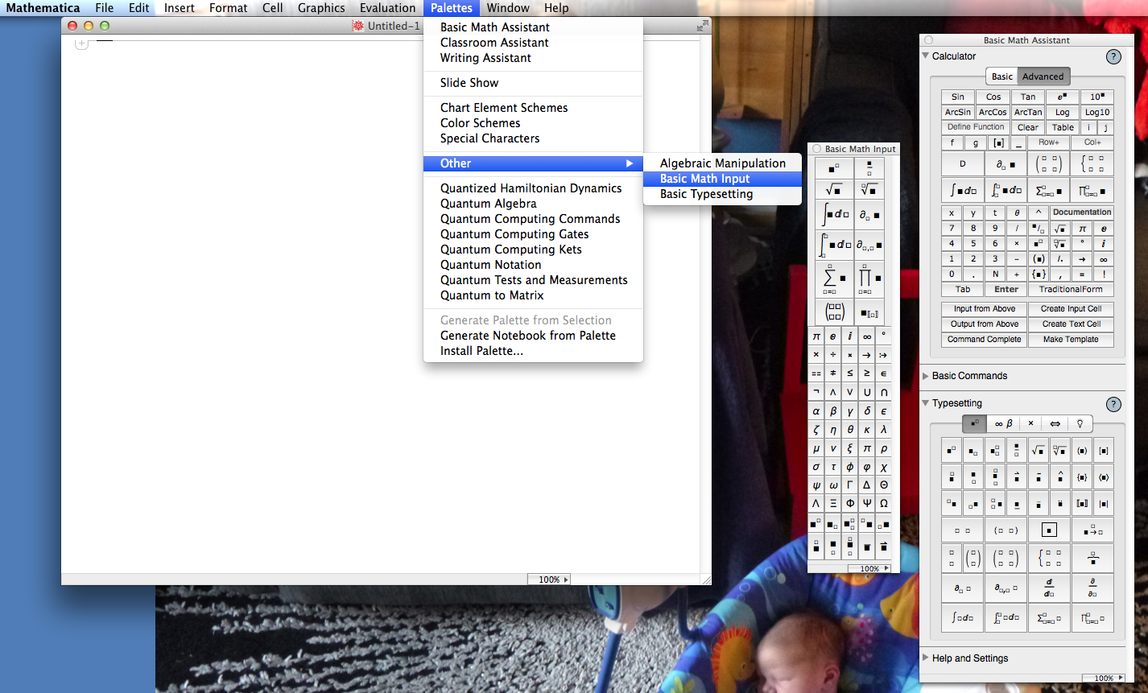
Finding your Way Around Mathematica
“Palettes” for fancyer notation
“Notebook” area

Slide 4
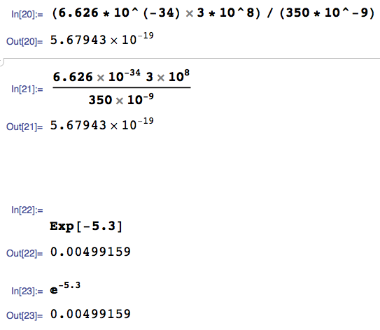
How do I enter a calculation?
Type it in like you would on a calculator
Type <SHIFT><RETURN> to evaluate
Make it a little more readable with fancy notation from the palettes
This is a way to e something quickly
A little fancier notation with help from the palettes

Slide 5
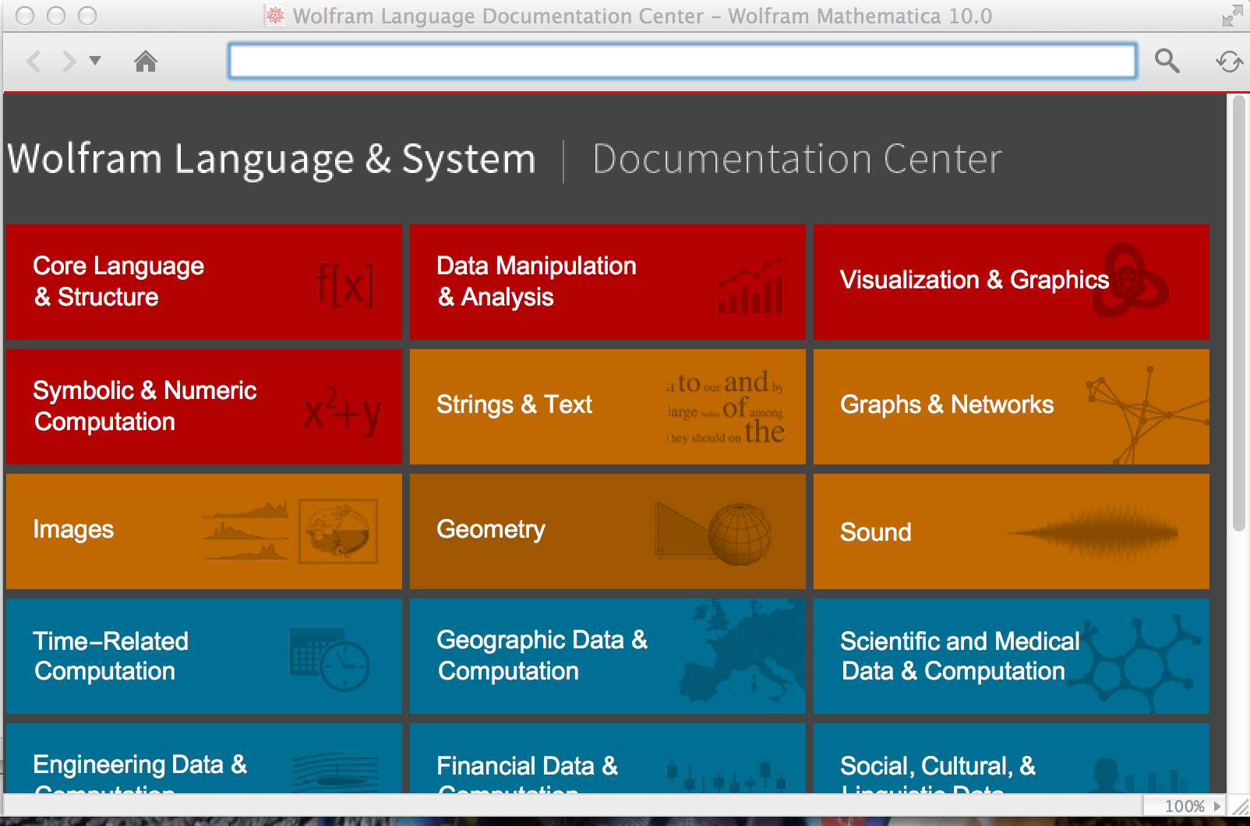
Mathematica Help is Your Friend
Search Box

Slide 6
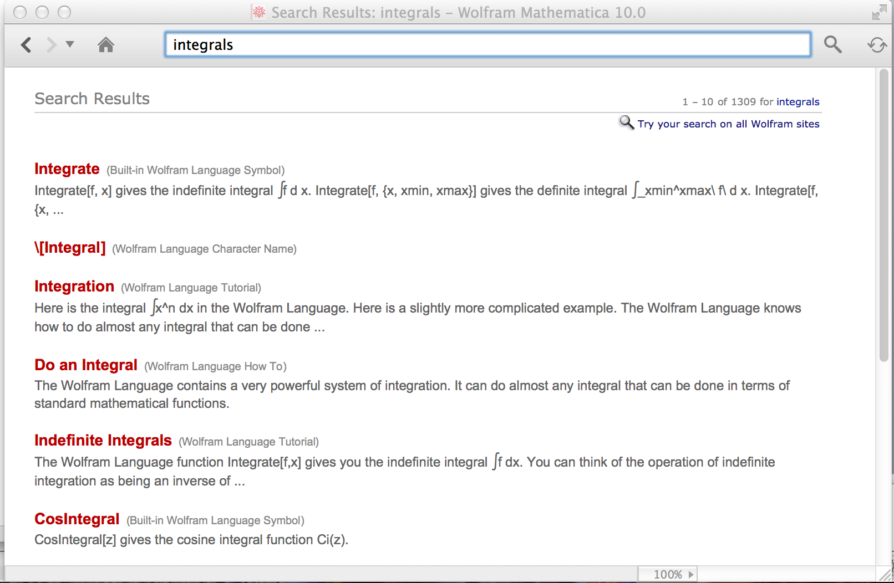
Mathematica Help is Your Friend
How do I do integrals in Mathematica?
A possible search term:
Clickable
results:

Slide 7
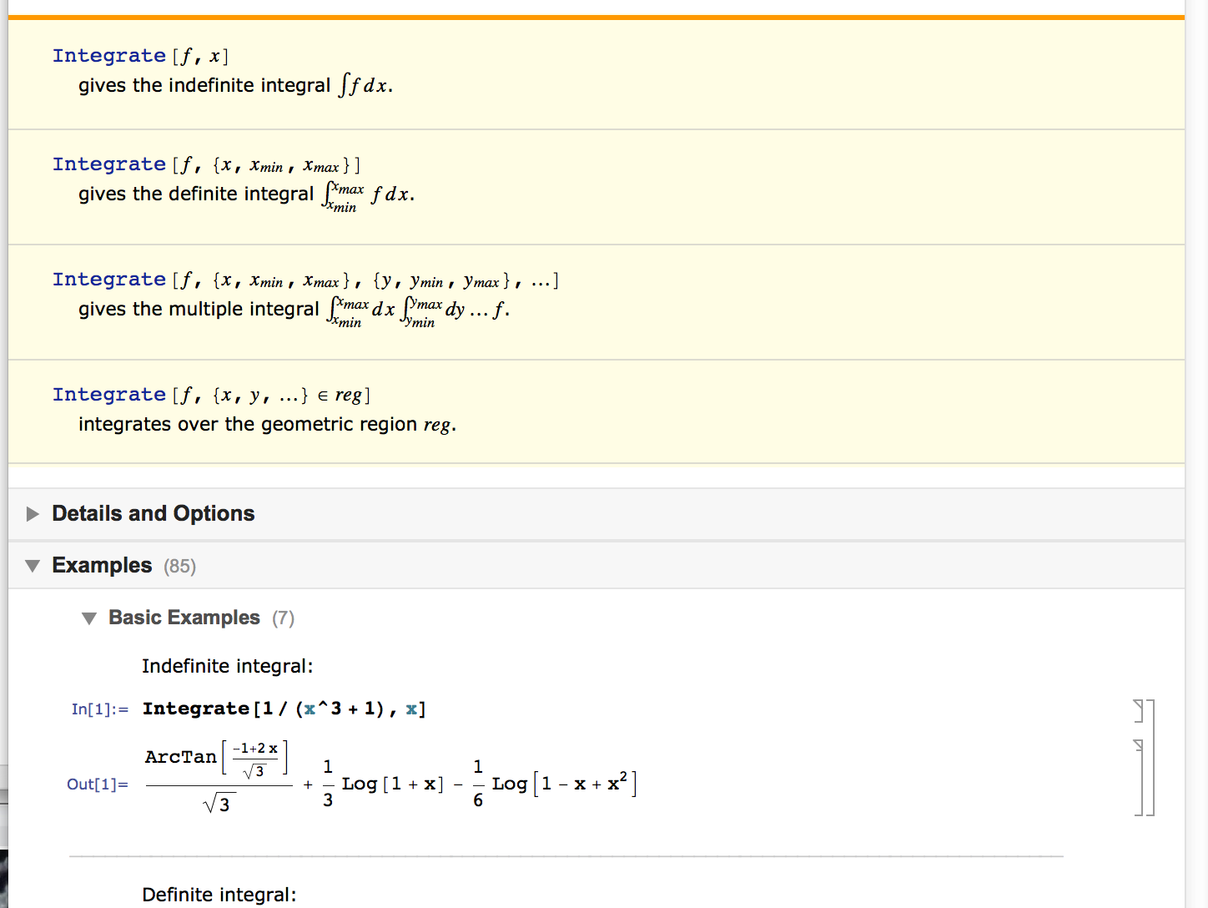
Mathematica Help is Your Friend
Basic structure of a Mathematica help page:
Function syntax. Usually not too helpful for beginners:
Runnable examples!! Very helpful for beginners!

Slide 8
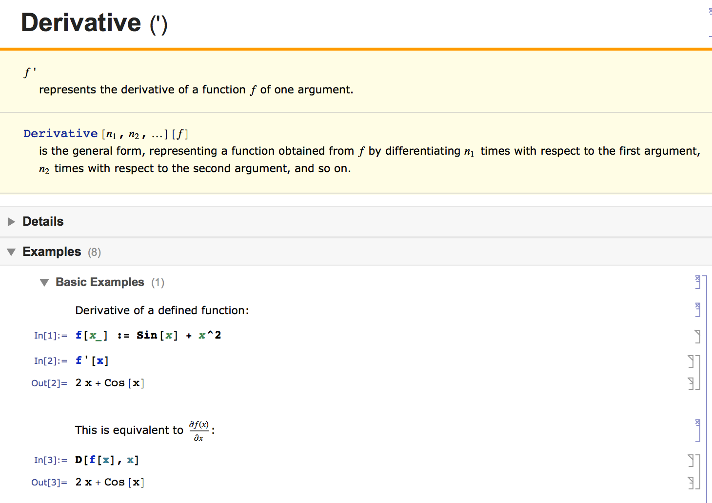
Derivatives in Mathematica

Slide 9
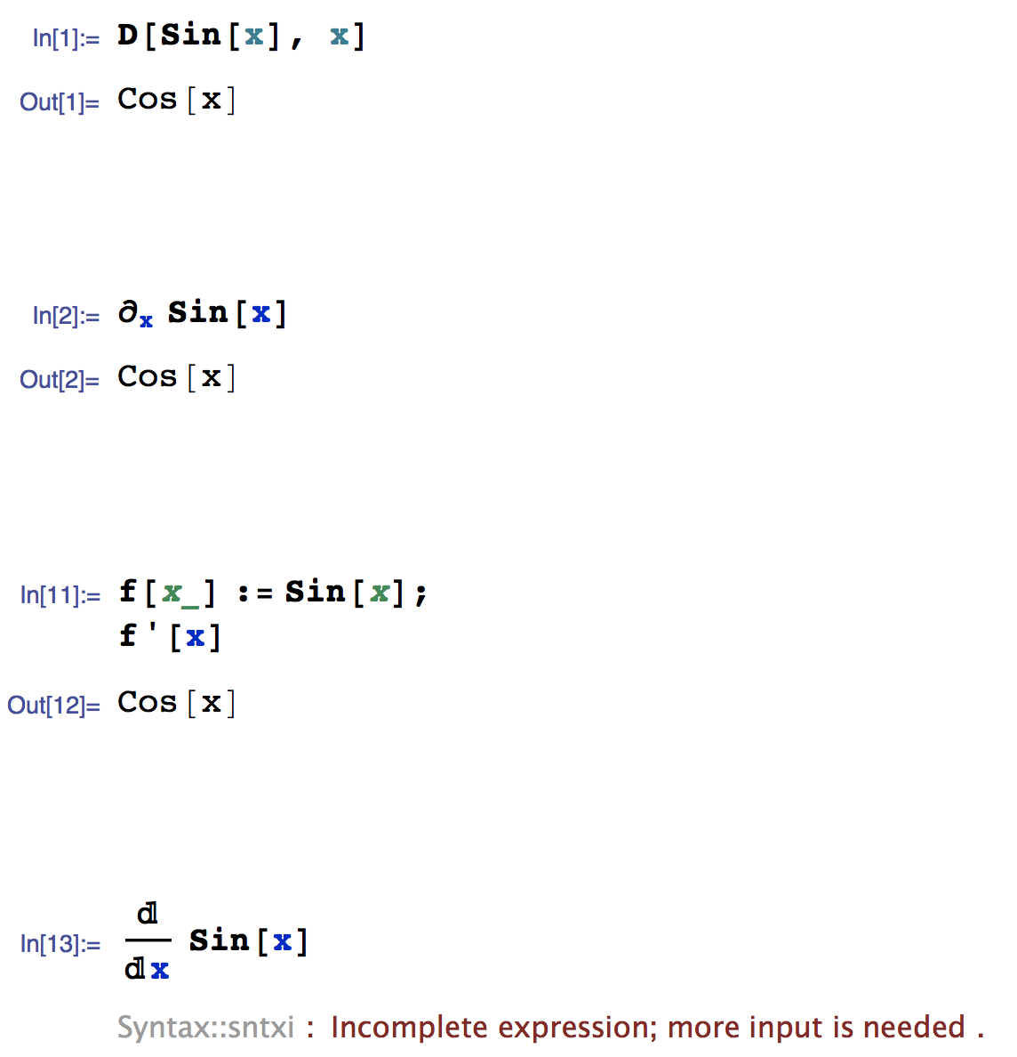
Derivatives in Mathematica
Fastest way to request a derivative
A little fancier notation using special symbol from a palette
When fefining a “symbolic function” you can use ‘ notation
This doesn’t work ☹

Slide 10
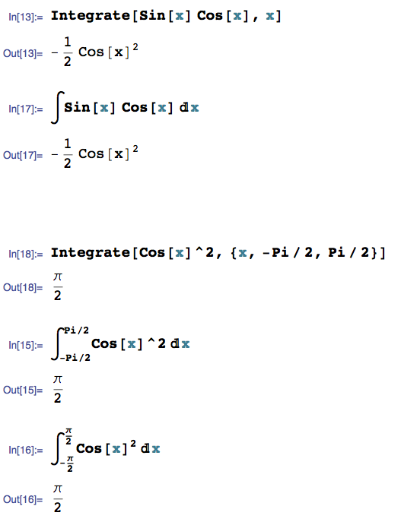
Integrals in Mathematica
Fastest way to type in an integral
A little fancier notation using special symbol from a palette
For definite integrals
Pi means π means 3.1415…
If you like, you can get really fancy with the notation using the palettes

Slide 11
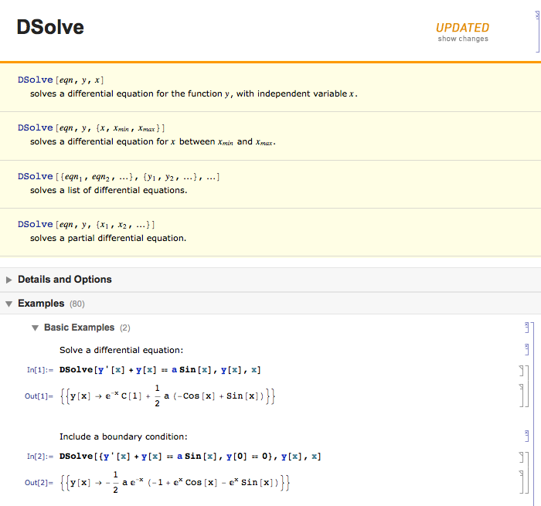
Differential Equations in Mathematica

Slide 12
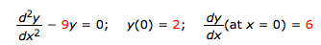
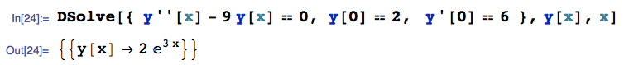
Differential Equations in Mathematica
Lets follow the pattern on the help page and solve one:
Diff eq we want to solve
Extra initial conditions specified to get a specific solution
Solution: y(x) = 2 e^{3x}

Slide 13
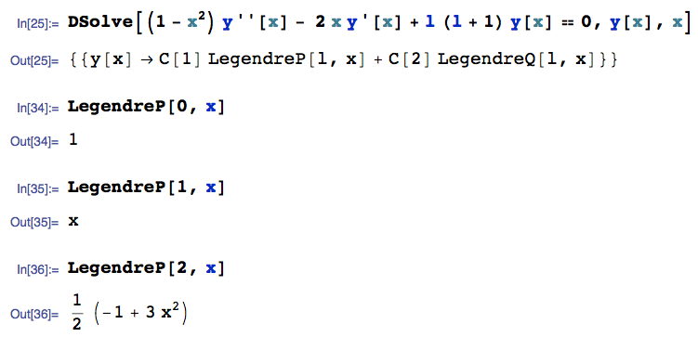
Differential Equations in Mathematica
Since this is a computer, we can ask it to do real fancy stuff too ☺ :

Slide 14
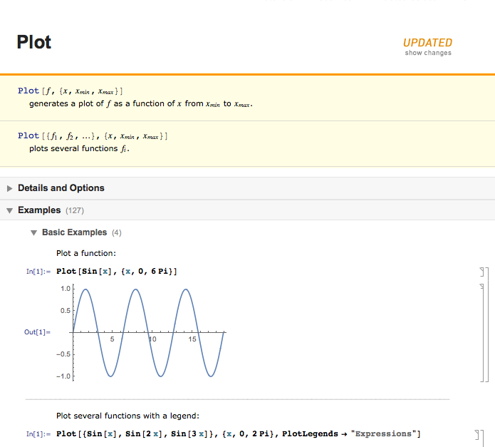
Basic Plotting in Mathematica

Slide 15
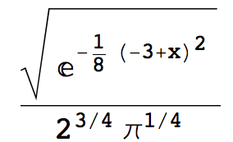
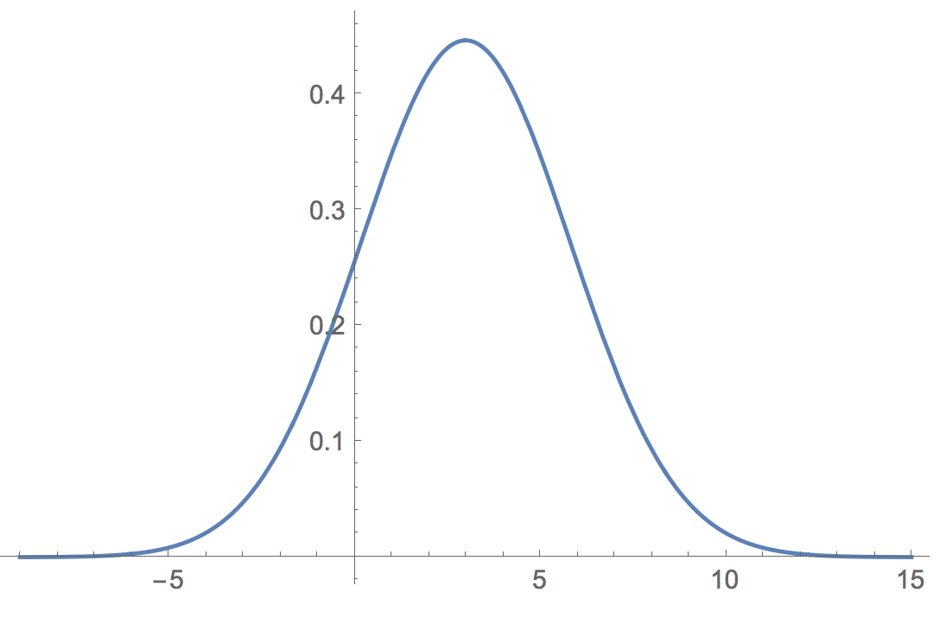
Basic Plotting in Mathematica
Plot the function between -15 and 15:
In[1]:=
p = (2^(3/4)* Pi^(1/4))^(-1)*Sqrt[Exp[-(1/8)*(x - 3)^2]]
Out[1]:=
In[2]:=
Plot[p, {x,-9, 15}]
Out[2]:=

Slide 16
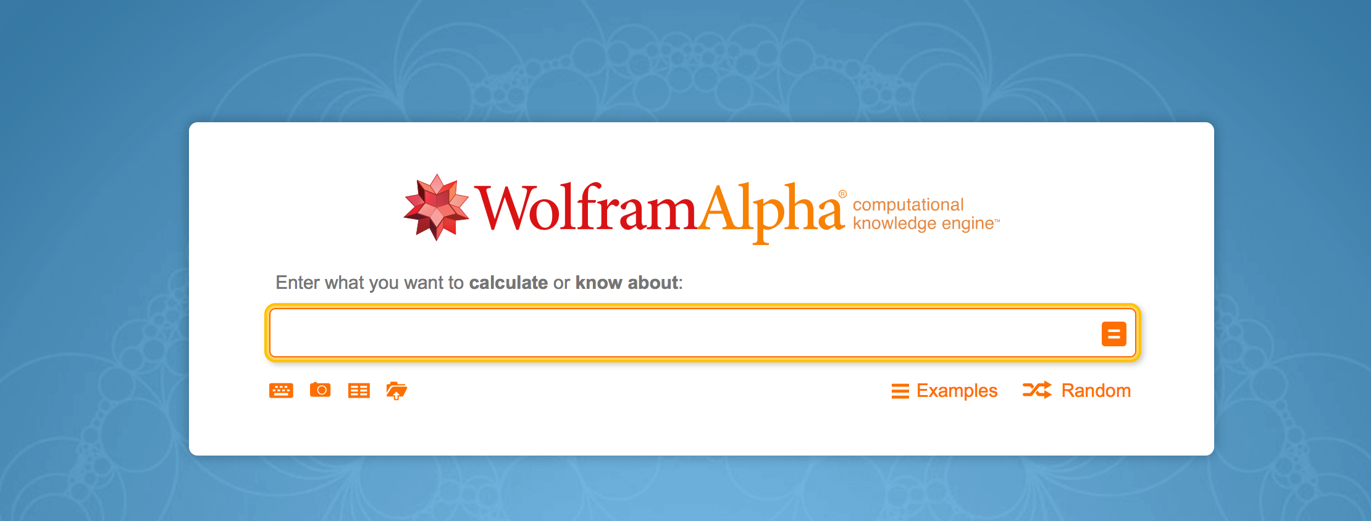
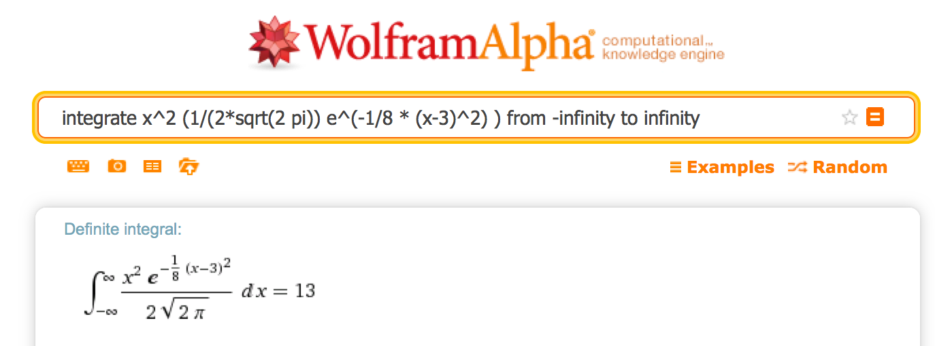
Mathematica on the Web For Free!
Hey, we can even use the interwebs: Wolfram Alpha:
http://www.wolframalpha.com/
E[X²]

Slide 17
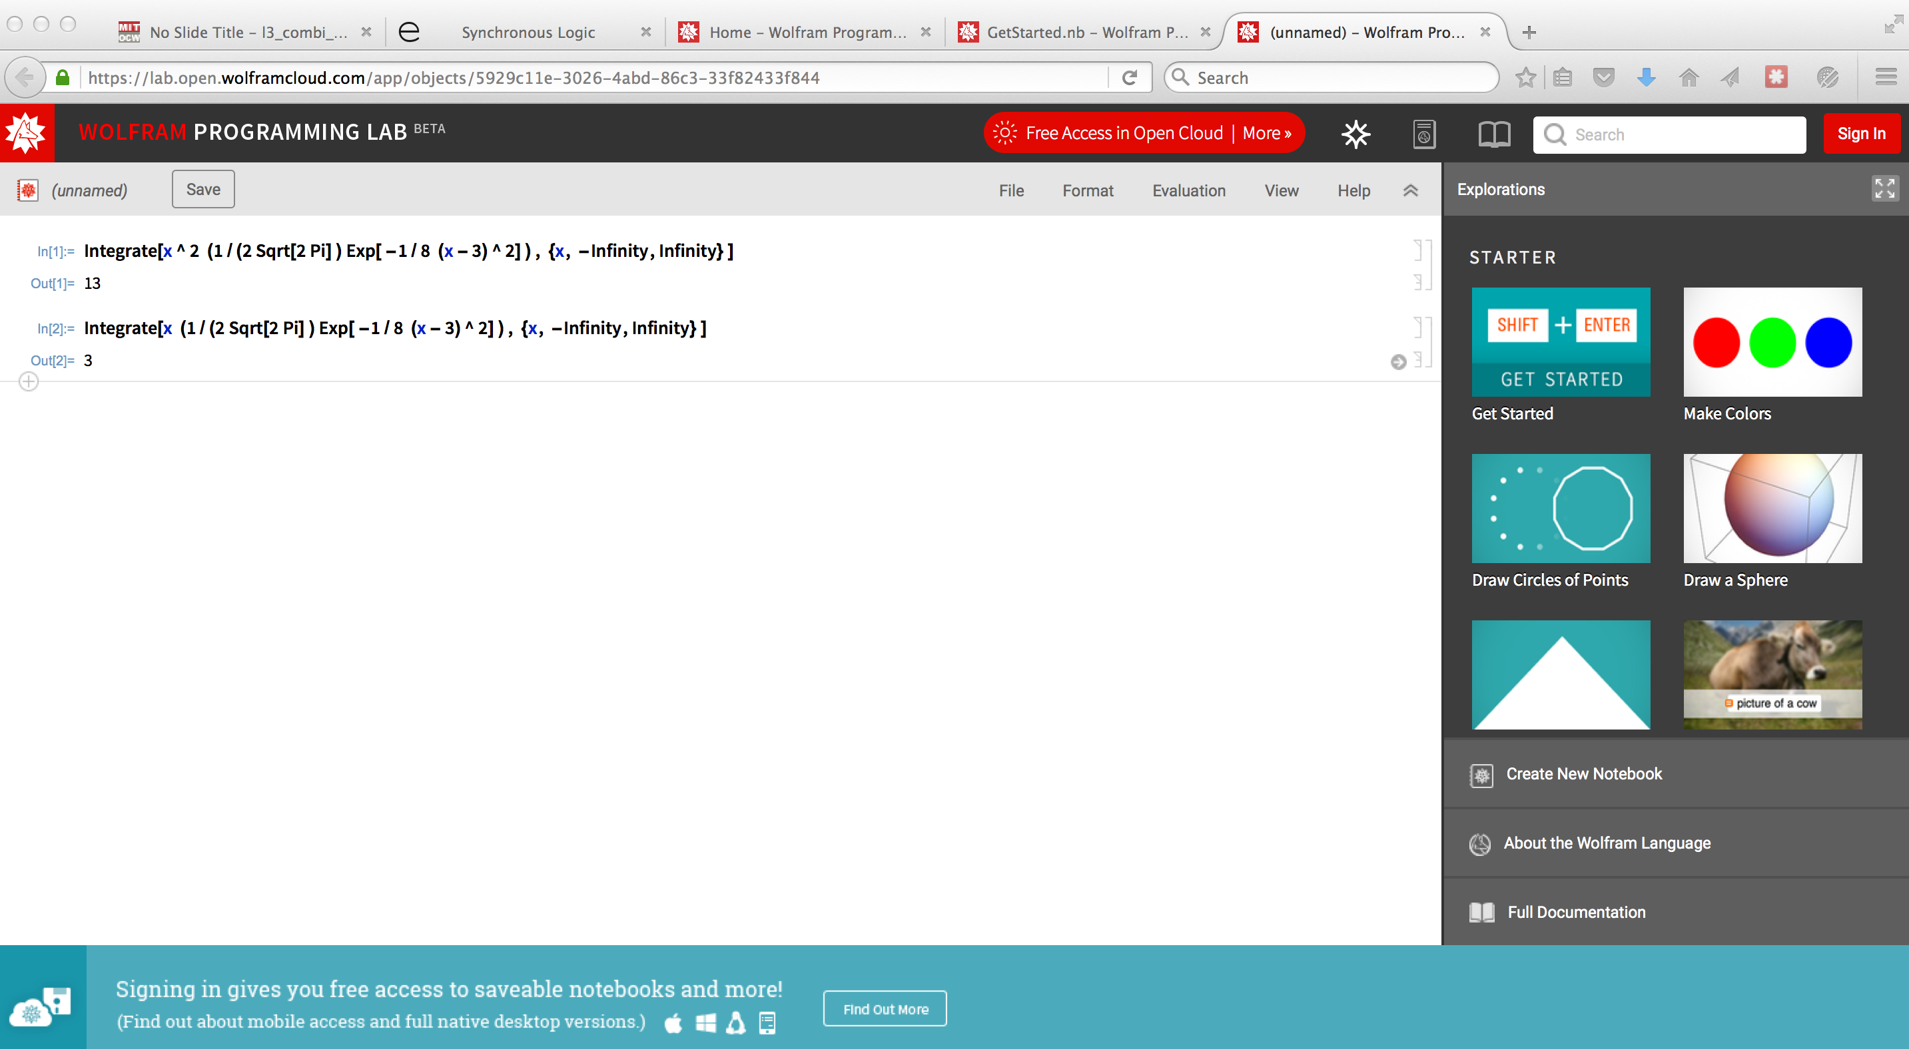
Mathematica on the Web For Free!
Hey, we can even use the interwebs –OR–: Wolfram Programming Lab!!:
https://lab.open.wolframcloud.com/objects/wpl/GetStarted.nb
E[X²]
E[X]
This is old text-input based Mathematica but is VERY POWERFUL.
Definitely worth learning, especially because it’s FREE!
The Help is great and easy to use!!!!

Slide 18
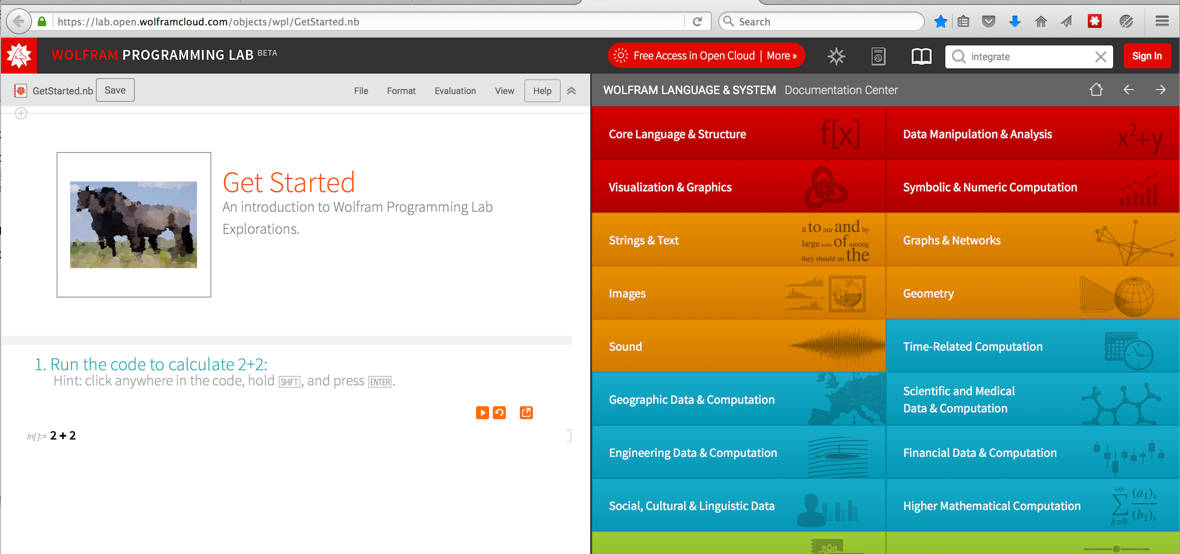
Mathematica on the Web For Free!
Hey, we can even use the interwebs –OR–: Wolfram Programming Lab!!:
https://lab.open.wolframcloud.com/objects/wpl/GetStarted.nb
Type in search terms

Slide 19
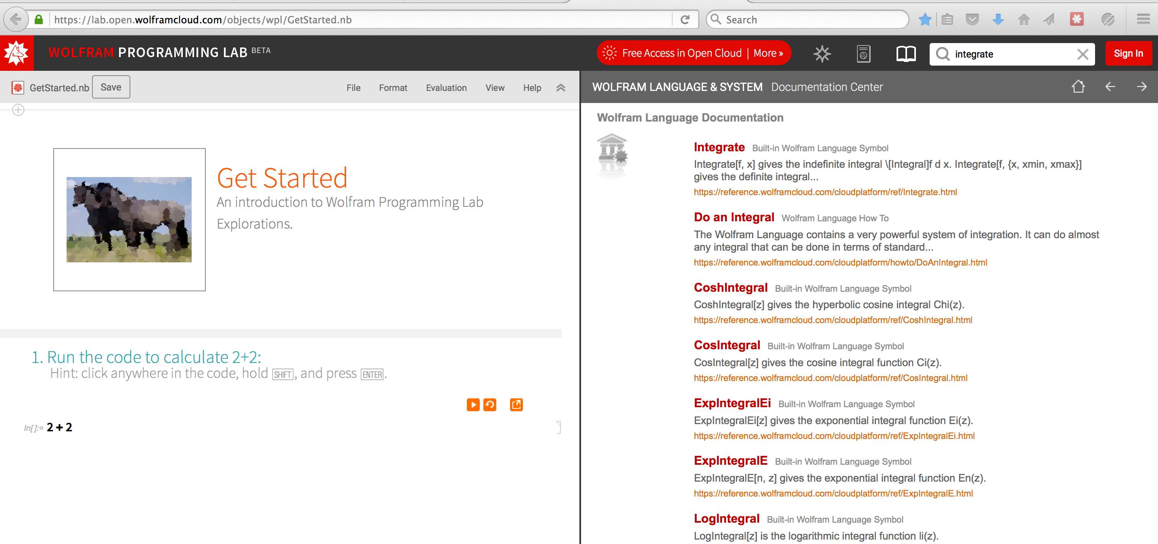
Mathematica on the Web For Free!
Hey, we can even use the interwebs –OR–: Wolfram Programming Lab!!:
https://lab.open.wolframcloud.com/objects/wpl/GetStarted.nb

Slide 20
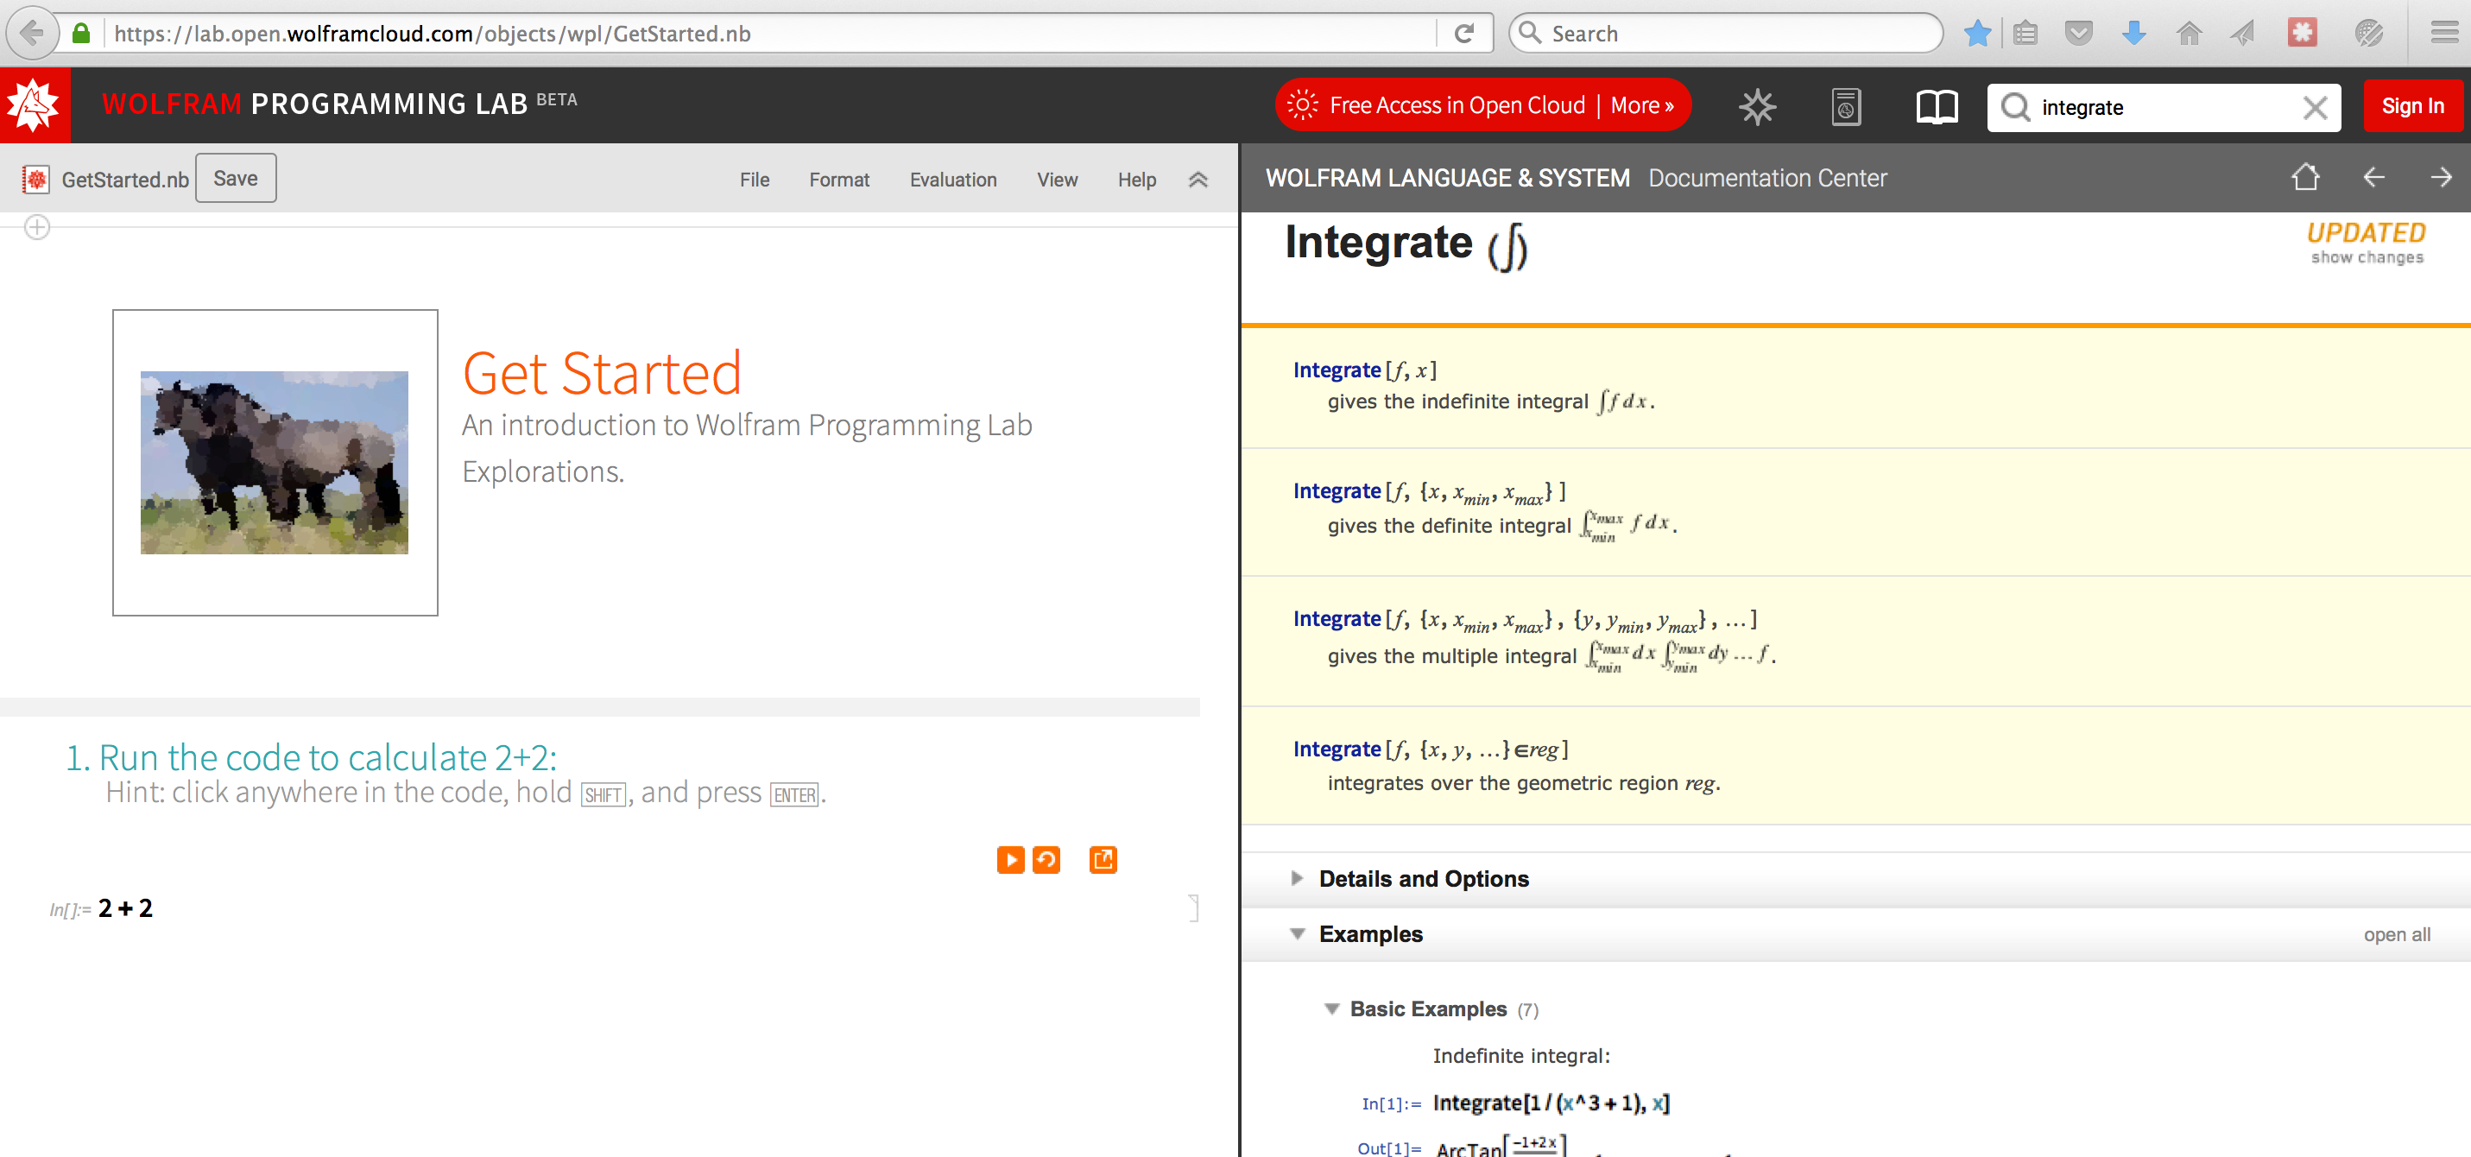
Example: Moments and Expectation Values
Hey, we can even use the interwebs –OR–: Wolfram Programming Lab!!:
https://lab.open.wolframcloud.com/objects/wpl/GetStarted.nb
Examples you can try out, click on, cut and paste!!!!

Slide 21
Example: Integration with Mathematica: Expectation Values
Say an object’s wave function is:
Give an expression for the variance of x (the object’s location) with respect to the wave functions corresponding its probability distribution.
In other words, evaluate the below and show it is equal to 4:

Slide 22
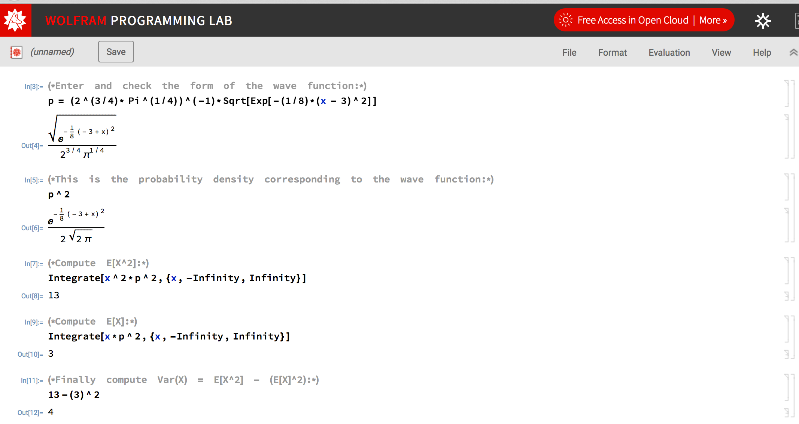
Example: Integration with Mathematica: Expectation Values

